Slide 1
FBI
Principal, King History 1994
CAR(Carl-Benz)
1900 Max-Plank Former Federal Republic of (US) Germany
1909 Albert Einstein uses Max-Plank (Physics Algorithms to explain Quantum)
1945 Albert Einstein Manhattan Project
2000 Max-Plank Institute Checkpoint Charlie
2019 Police Manhattan
2023 Police Fort Worth
Government Texas
United States Government
Federal Court and Federal Republic(US) Germany Court (Dr. Behr) Michigan, LLM
WMD
Max Plank Institute
2016 Dr. Dr. Prof. Joachim F.
JFK.BULLET
Albert Einstein Moon Gravity Waves
Atomic Factory
Philipsburg
Research Center Gorgbachev(ibm.dmiler.evegalium.employ.michea.heger)
Recsearch Center KIT
KIT ibm.demail.pope.francesco
ibm.daimler.WAR
ibm.daimler.Whitehouse
B-10
Max-Plank Heat Radiation CHILD ABUSE Toaster
Physics ibm.damiler.Thomas Physics Teacher
C++ nonPoliceRussian.nonPoliceAtomics

Slide 2
FBI
nonPoliceQuantum
WMD
nonPoliceQuantumMechanics
nonPoliceQuantumComputing
nonPoliceQuantumBit
nonPoliceQuantumByte
nonPoliceQuantumRadomAccessMemory
nonPoliceQuantum

Slide 3
FBI
nonPoliceQuantum
WMD
nonPoliceQuantumMechanics
nonPoliceQuantumComputing
nonPoliceQuantumBit
nonPoliceQuantumByte
nonPoliceQuantumRadomAccessMemory
nonPoliceQuantum

Slide 4
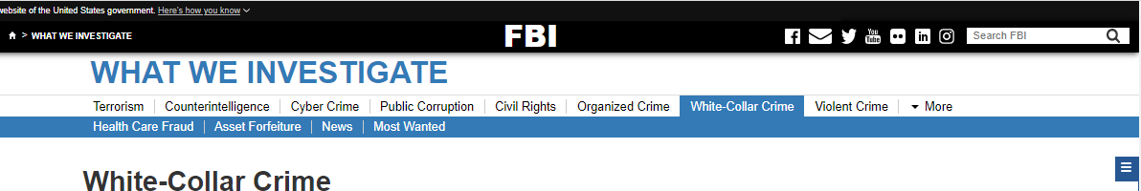
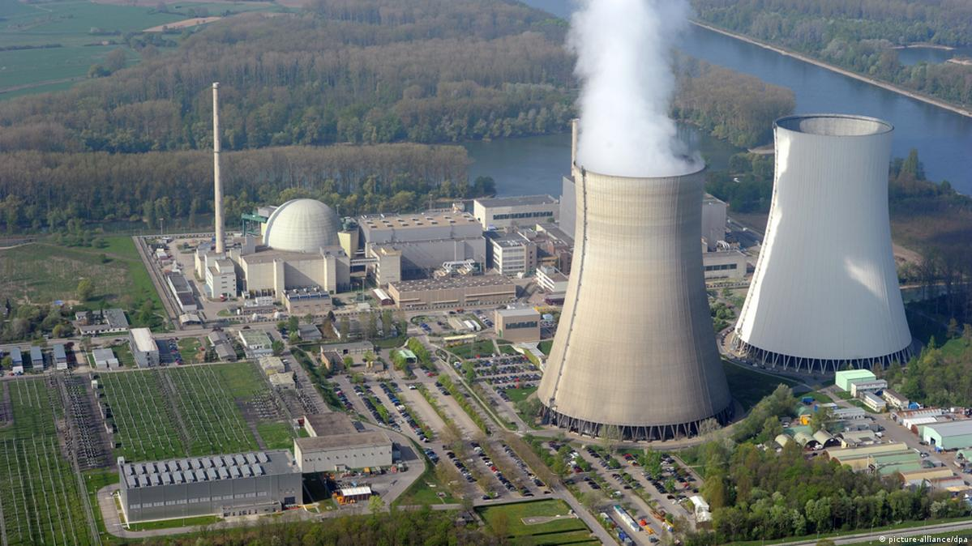
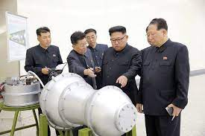
FBI
WMD
nonPoliceQuantum
§PHIL
nonPoliceQuantumMechanics
§CHANCLOR FEDERAL REPUBLIC GERMANY
Clean Engery
MAINSTREET
PHILIPSBURG
PHILIPSBURG MAINSTREE(VIEW)
1997 BEJAMIN FRANLIN,THANKSVIGING
PHINSGTUNIR
E=MC2
NAVY Philip Johson, Foster City
Angel Mekel Legilsatoin, NATO
CLOCK
nonPolicRTALogical
CLOCK
GOVMENT MANGMENT
E-=MC2 w/o mathematics
PostDoctor, Dr Disteration
GOVMENT MANGMENT

Slide 5
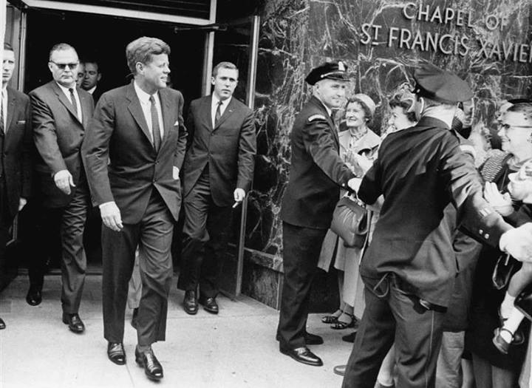
FBI
Ibm.damiler.
1990 CHECK POINT CHARLIE Max-Plank
2000 CHECK POINT CHARLIE Max-Plank
2005 Link IBM.DAMILER.1D8723
2013 CLOCK
2023 Fired ibm.daimler.chair
nonPoliceQuantum
WMD
Max Plank Institute
1990 Dr. Dr. Prof. Joachim F.
JFK.BULLET

Slide 6

FBI
WMD
nonPoliceQuantumMechanics
nonPoliceQuantum
nonPoliceQuantumComputing
nonPoliceQuantumBit
nonPoliceQuantumByte
nonPoliceQuantumRadomAccessMemory
nonPoliceQuantum
nonPoliceDoucmentsLogical
FBI (former East Germay Spy Mr. Enders sewsaw FORD ipx josphef)
Like

Slide 7
FBI
WMD
nonPoliceQuantum
nonPoliceQuantumComputing
nonPoliceQuantumBit
nonPoliceQuantumByte
nonPoliceQuantumRadomAccessMemory
nonPoliceQuantum
§PHIL
nonPoliceQuantumMechanics
§CHANCLOR FEDERAL REPUBLIC GERMANY
PHILIPSBURG

